Slide 1
Minimum Spanning Trees

Slide 2
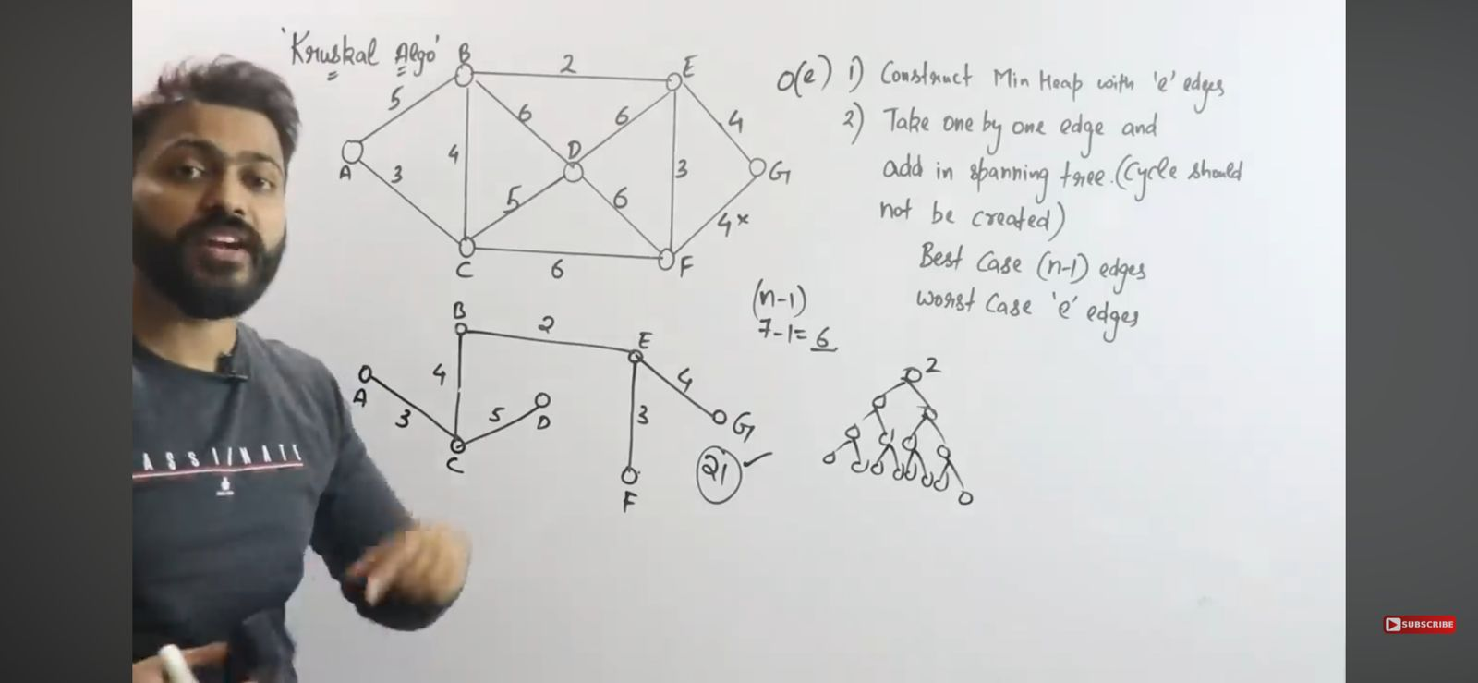
Kruskal Algorithm

Slide 4
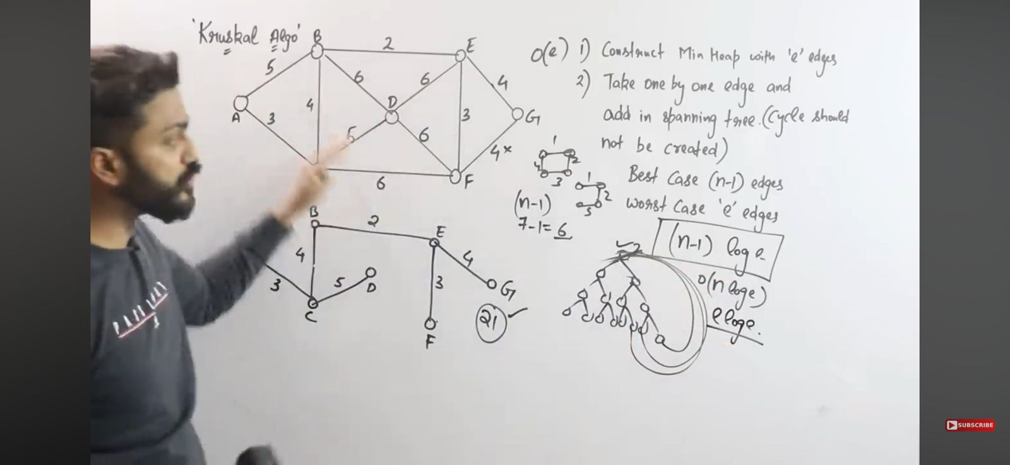

Slide 5
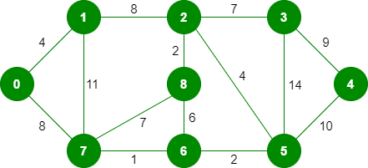
Exercise

Slide 6
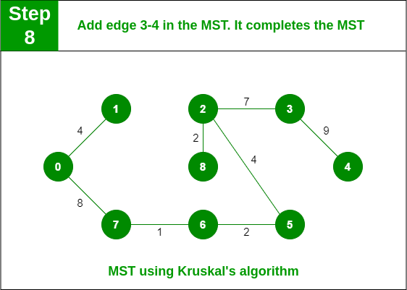
Solution

Slide 7
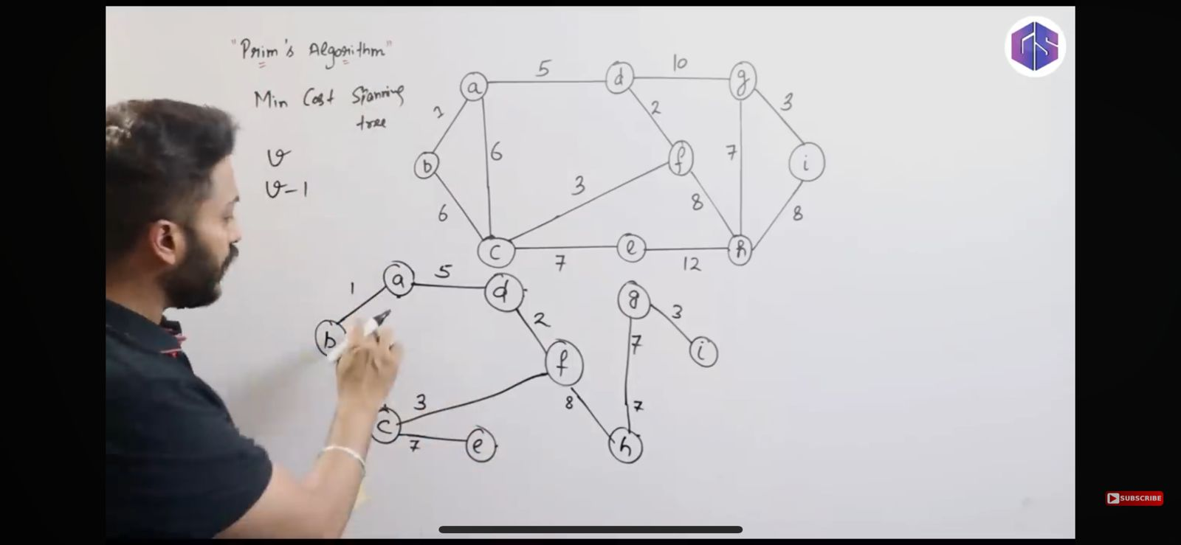
Prim’s Algorithm

Slide 8
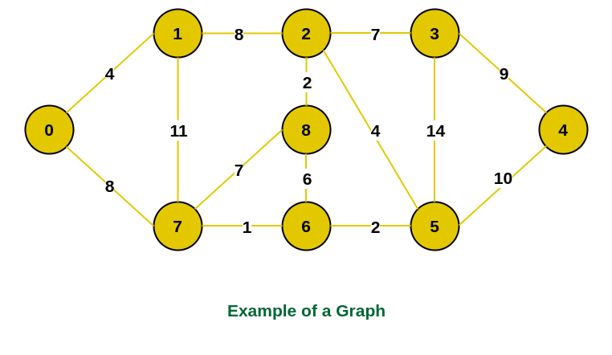
Exercise

Slide 9
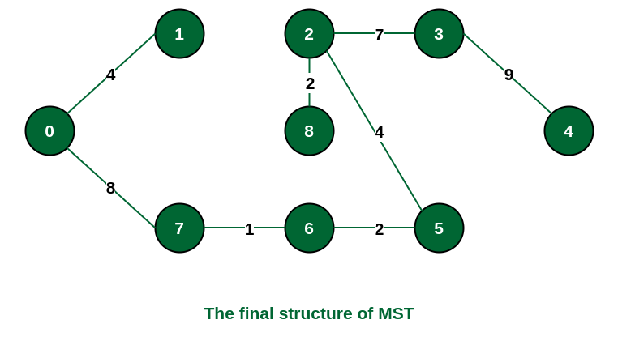
Solution

Slide 10
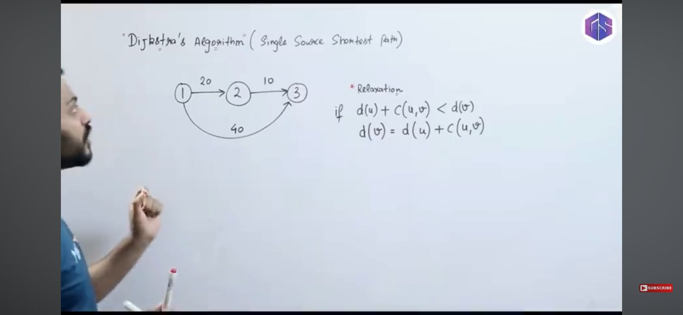
Dijkstra Algorithm (Single Source shortest path algorithm)

Slide 11
